Slide 1
EDA-project
by Jonatan Stursberg

Slide 2
personal hypothesis

Slide 3
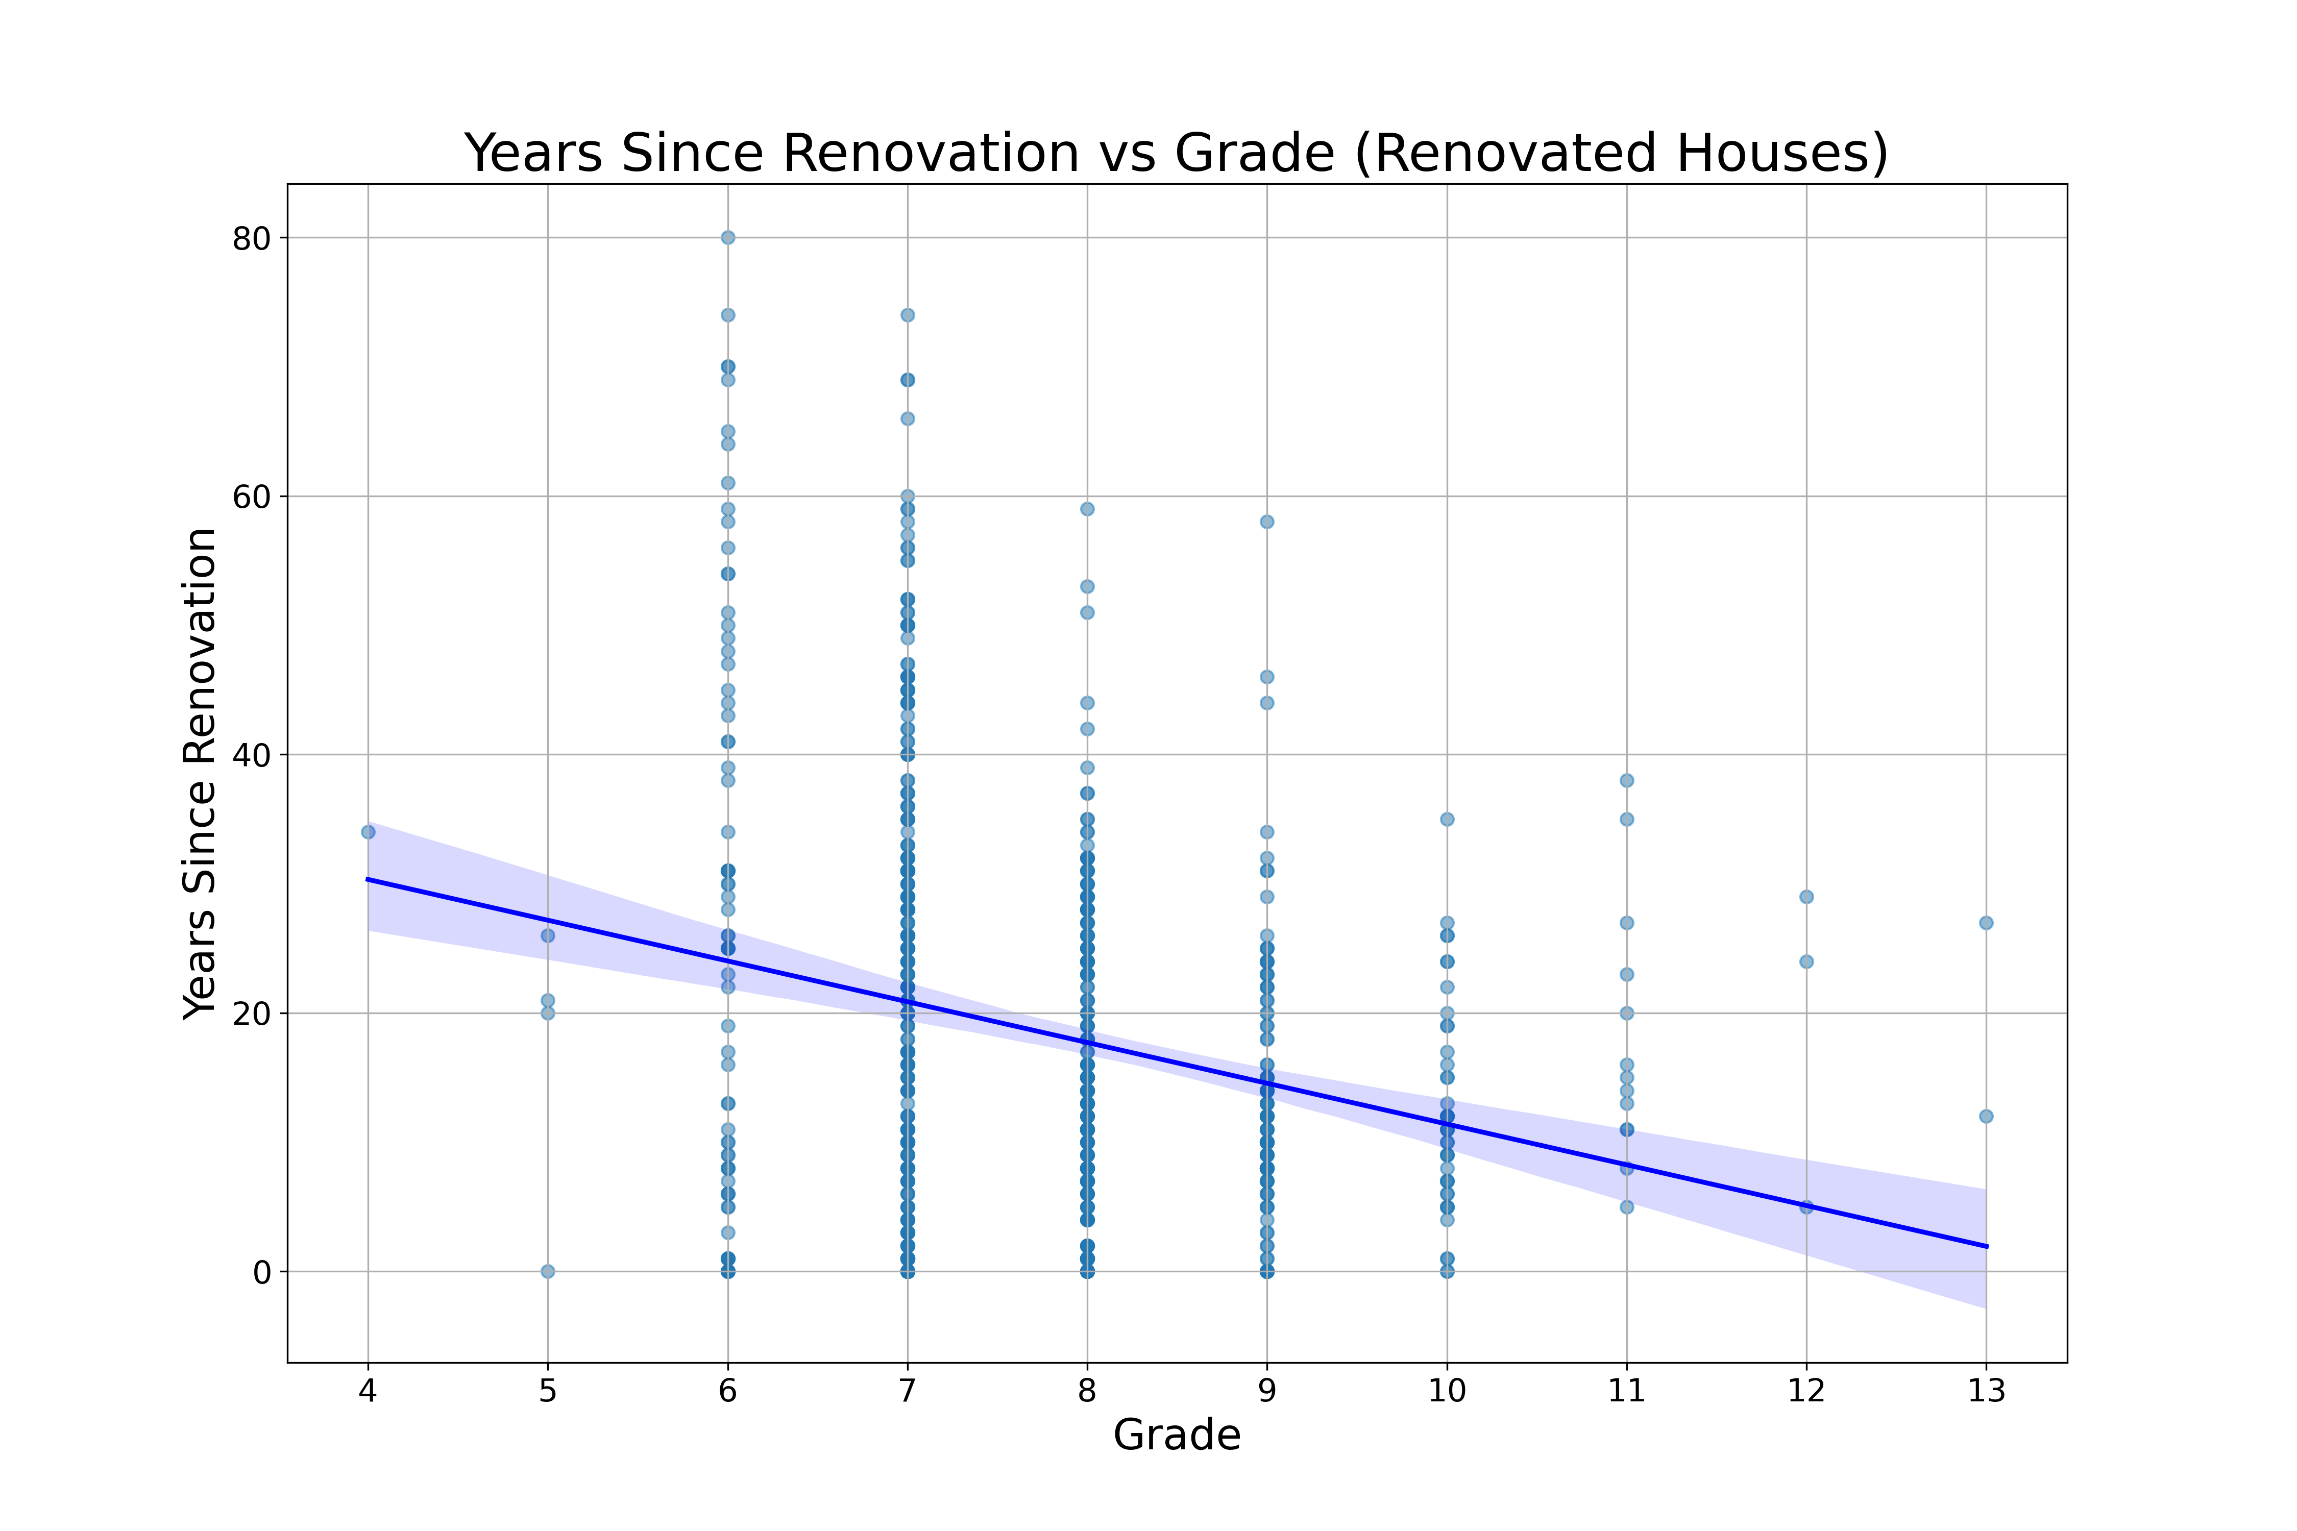
Hypothesis 1 → There should be a correlation between a high house's grade on one hand and time since renovation on the other hand.
Low number of records of renovated houses (631)
No scope of renovation in data
Weak correlation showing short time since renovation → higher grade

Slide 4
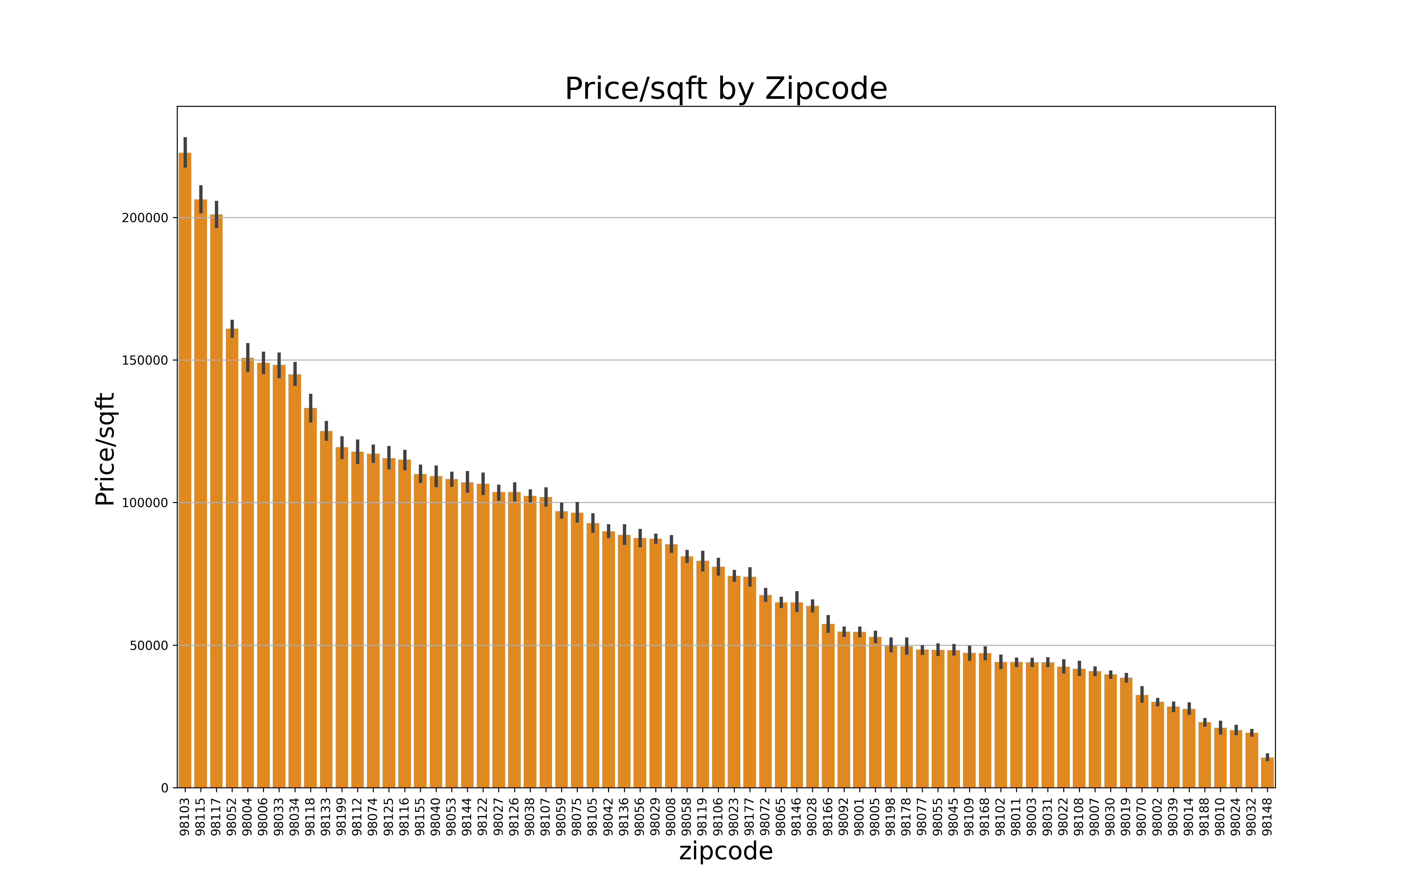
Hypothesis 2 → There should be a correlation between a high price per sqft and the location based on zip-codes.
Strong correlation between zip-code and price per living squarefoot
City center with high population density → high price per living squarefoot
Most likely different in rural areas

Slide 5
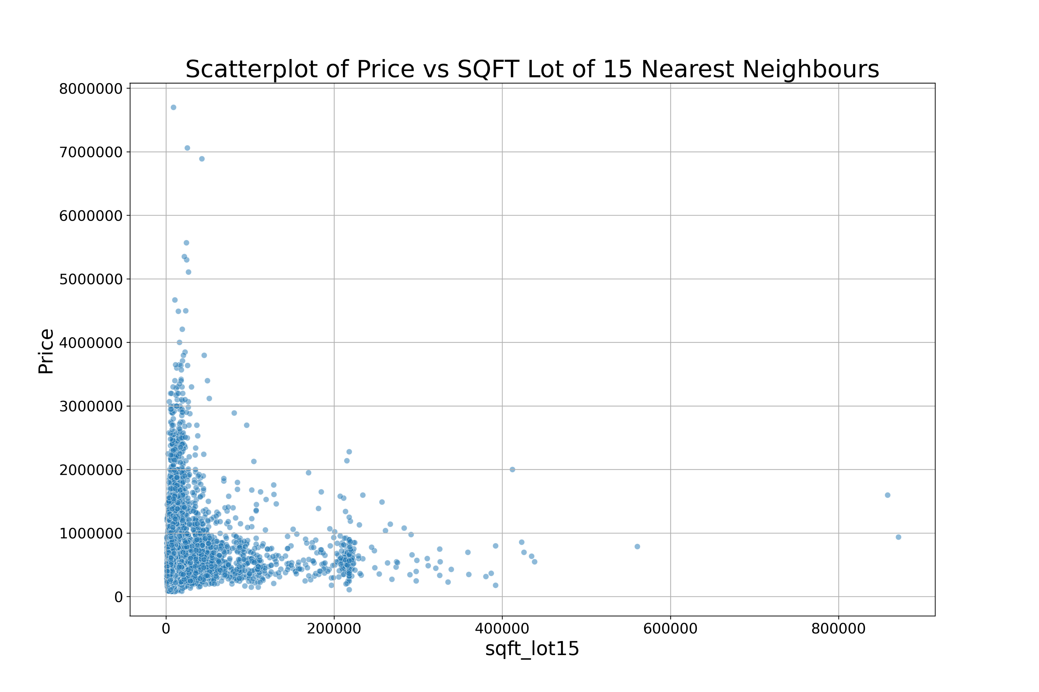
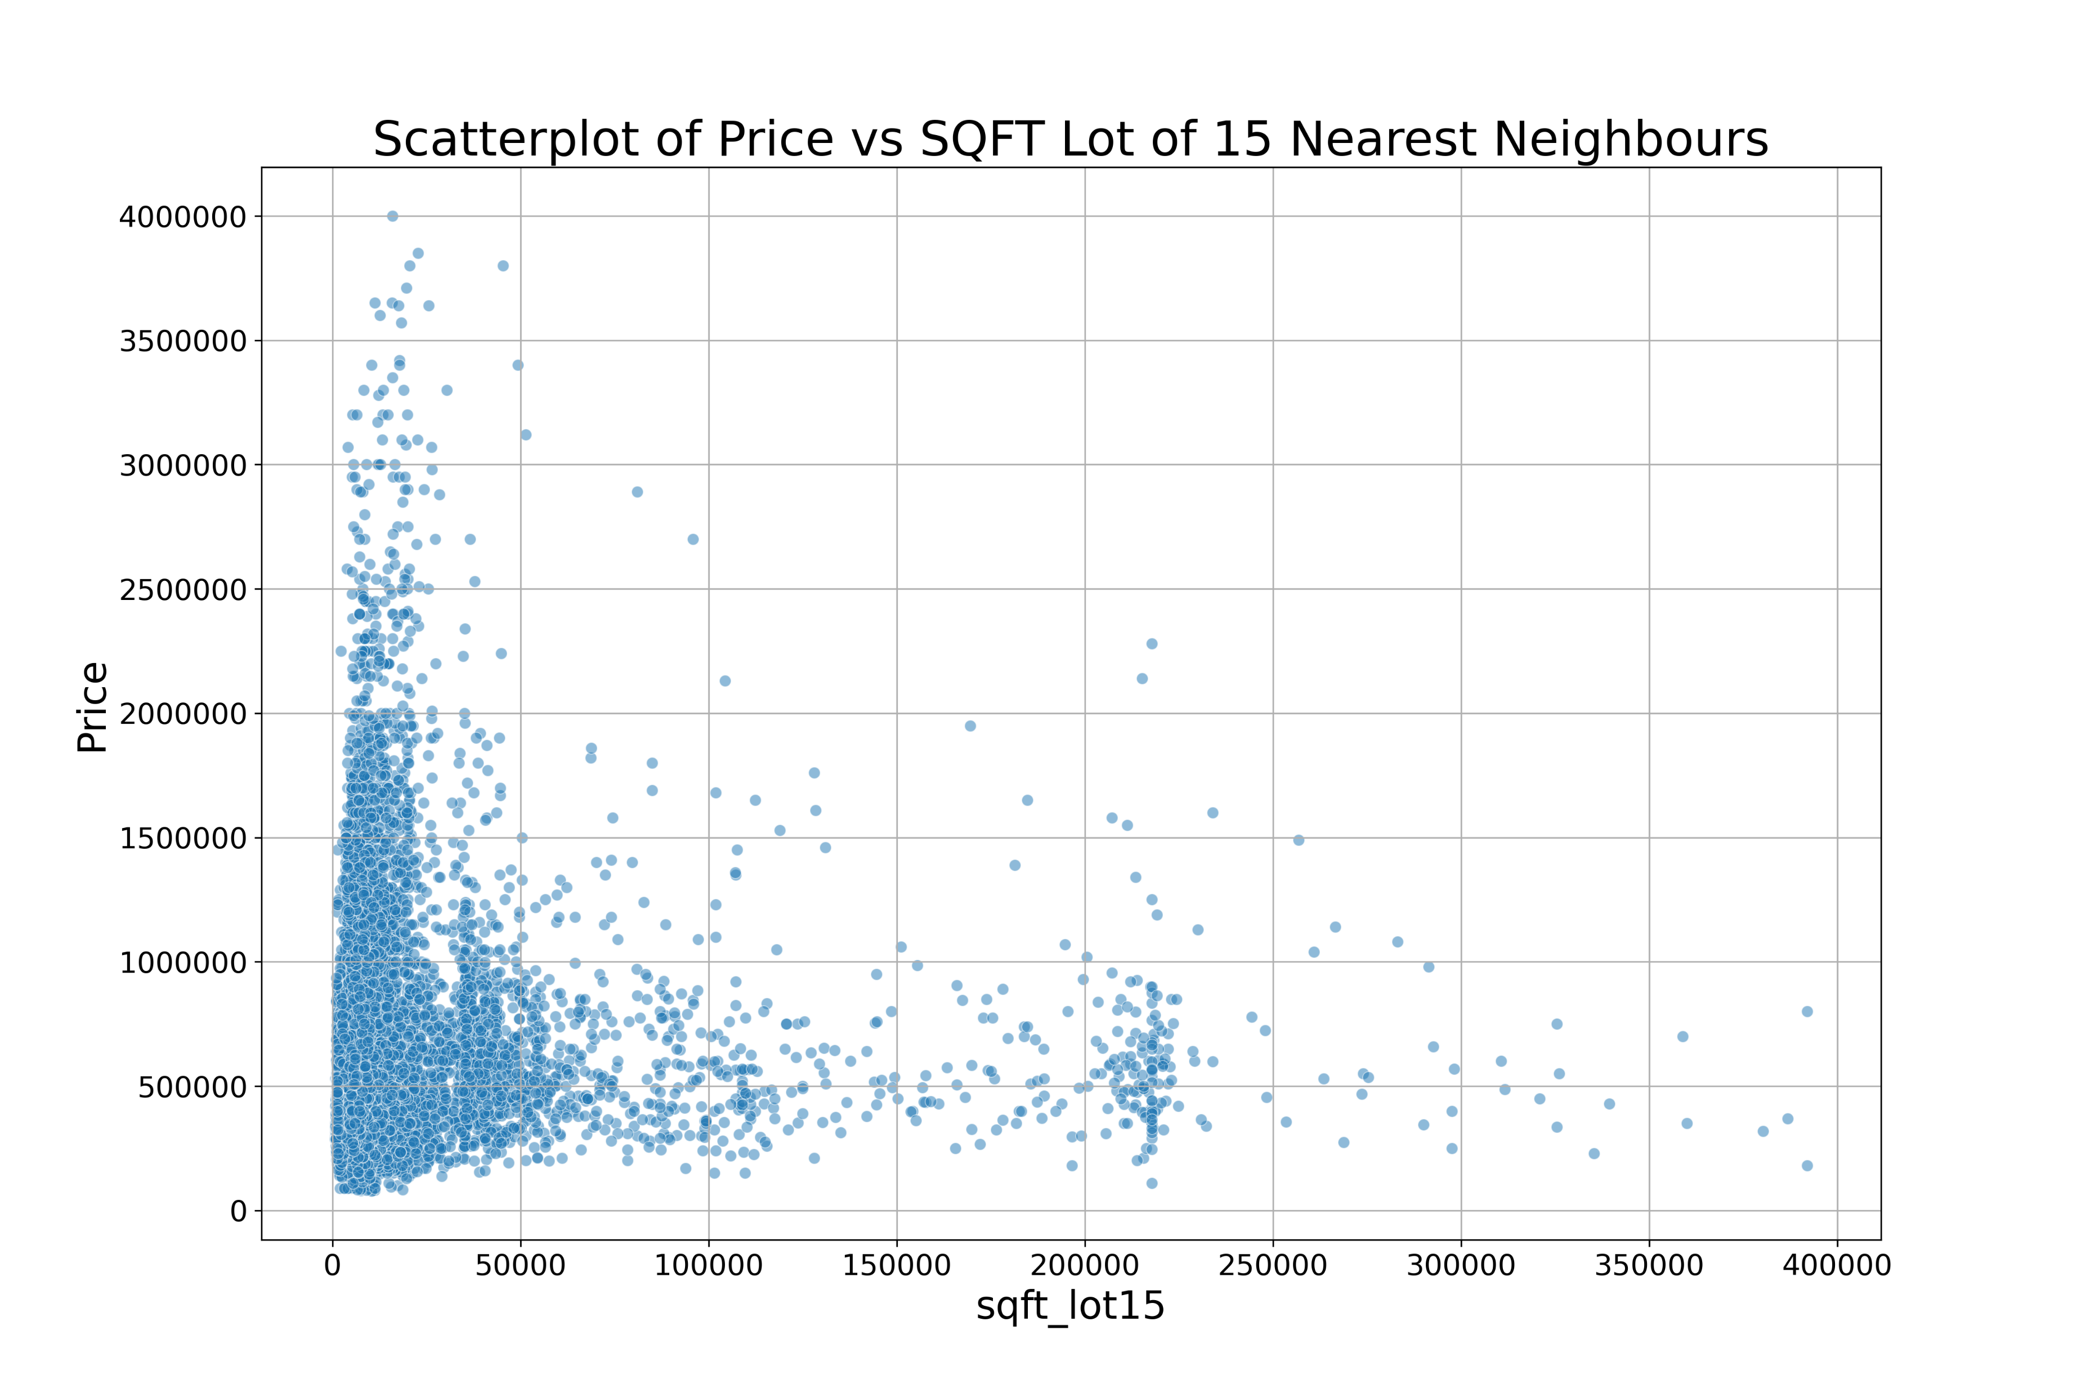
Hypothesis 3 → The higher price correlates to high sqft of nearest neighbours' houses.

Slide 6
Hypothesis 3 → The higher price correlates to high sqft of nearest neighbours' houses.
No clear correlation to be found
Houses of similar lot vary over a big span of prices
Houses of similar price have a high variance in price

Slide 7
My customer

Slide 8
Client Zachary Brooks
A seller seeking for high profits
Invests in historical houses in the best neighbourhoods
Asking for best timing to sell within a year?
Unsure about renovation contributes to profit optimisation?

Slide 9
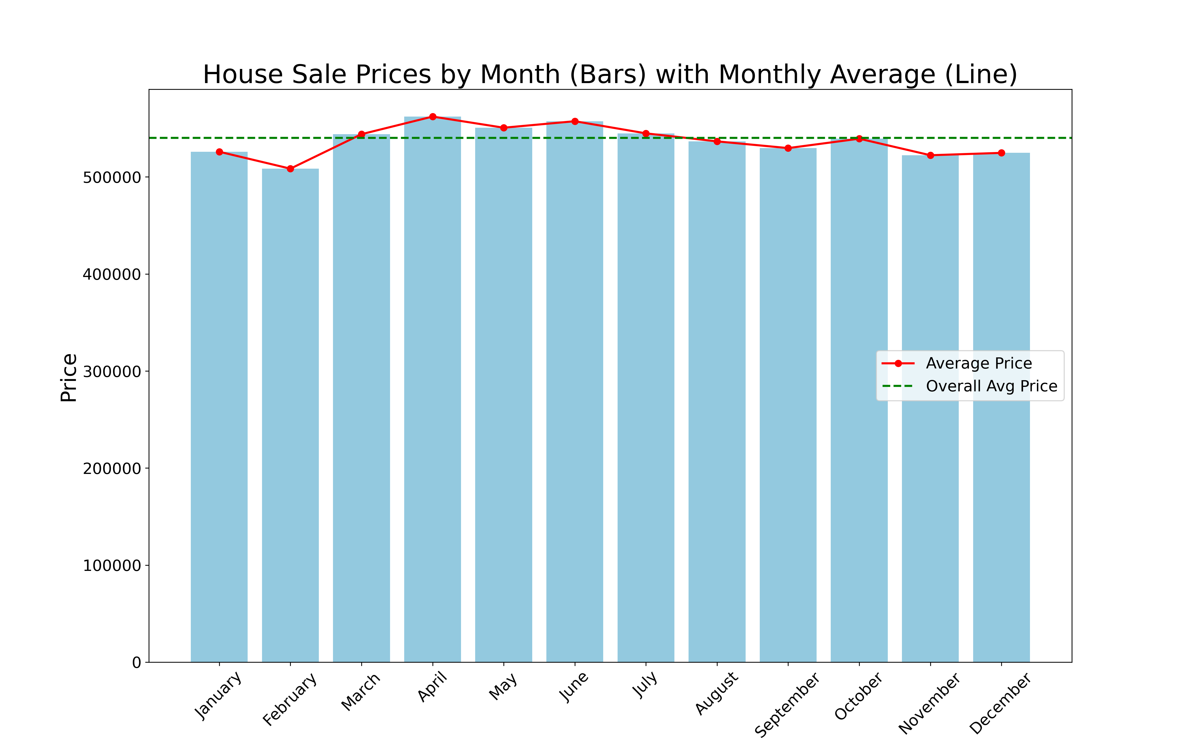
Timing for selling and buying → high profit
House prices vary over the year
February: prices below average
→ time to buy
April: prices above average
→ time to sell

Slide 10
Backup

Slide 11
Hypothesis 1 → There should be a correlation between a high house's grade and short time since renovation

Slide 12
Hypothesis 2 → There should be a correlation between a high price per sqft and the location based on zip-codes.

Slide 13
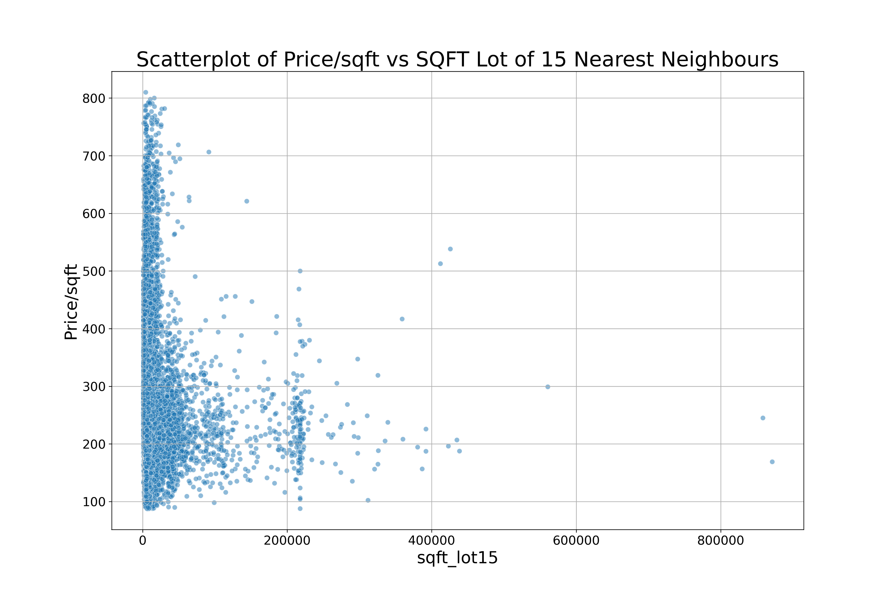
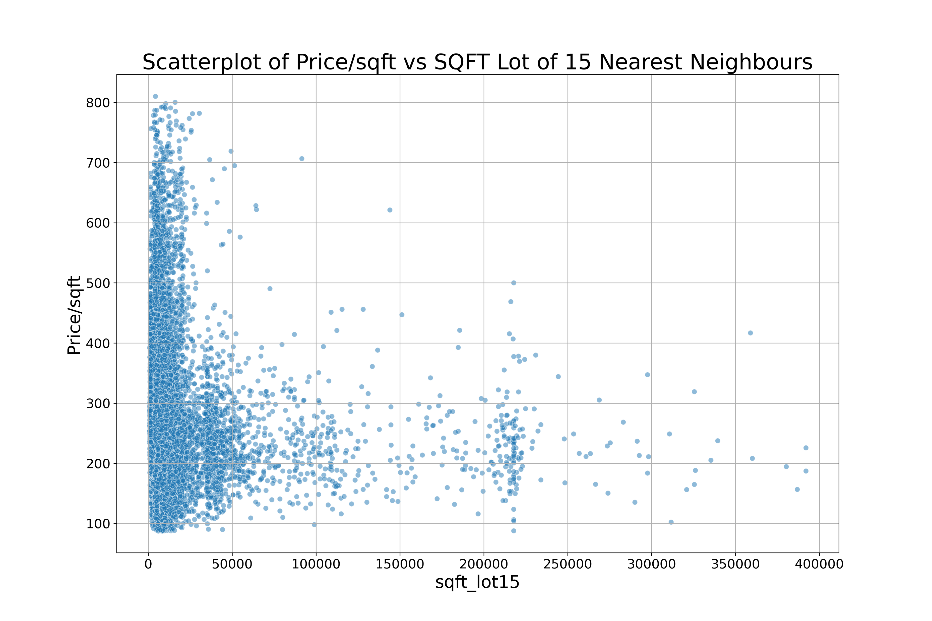
Hypothesis 3 → The higher price correlates to high sqft of nearest neighbours' houses.

Slide 14
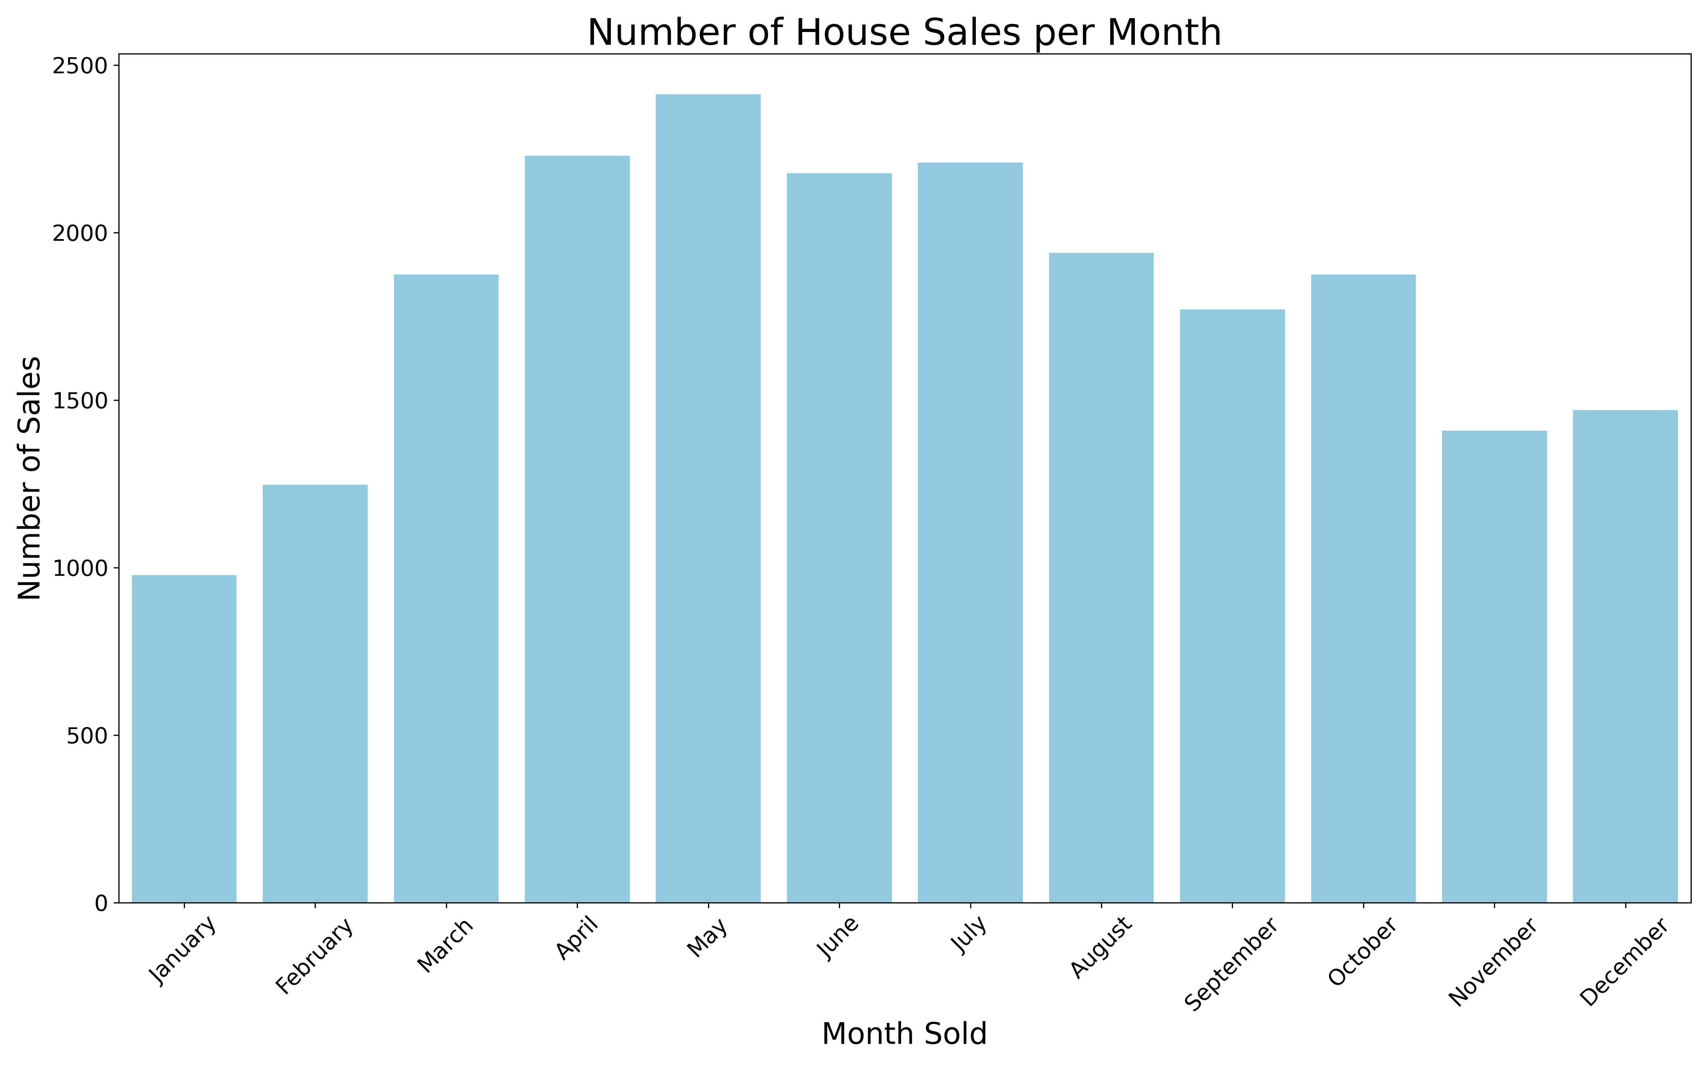
Timing for selling and buying → high profit

